Slide 1
Servers and clients
By Team AWS ERA

Slide 2
What is a Servers
A server in its most basic form: Is a computer device that runs in a program or process dedicated to running one or more server programs.
These service programs range in variety depending on what the server is designed for like LAN,WAN,MAN
Using internet technologies, devices are able to establish a connection to a server to access it and make use of the resources or programs on the servers.

Slide 3
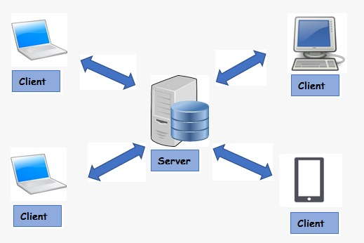
clients
Client - A system that uses remote services from a server.
The main operations of the client system are listed below:
→Managing the user interface.
→Accepts and checks the syntax of user inputs

Slide 4
server
Operating System(OS) configuration classified into two types,
→Work group
→Domain

Slide 5
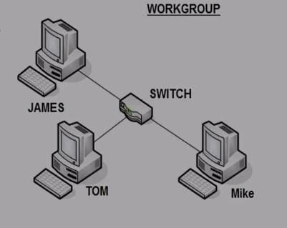
Work group
All computers are peers; no computer has control over another computer. Each computer has a set of user accounts. To use any computer in the workgroup, you must have an account on that computer.
There are typically no more than ten to twenty computers .All computers must be on the same local network or subnet.

Slide 6
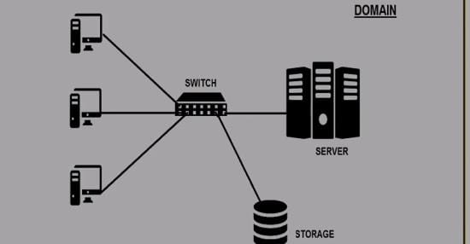
DOMAIN
One or more computers are servers. Network administrators use servers to control the security and permissions for all computers on the domain. This makes it easy to make changes because the changes are automatically made to all computers.
If you have a user account on the domain, you can log on to any computer on the domain without needing an account on that computer. There can be hundreds or thousands of computers. The computers can be on different local networks

Slide 7
Adds &Domain controller
ADDS-Active Directory Domain Services
Active Directory (AD) is a database and set of services that connect users with the network resources they need to get their work done.
A domain controller is a server that responds to authentication requests and verifies users on computer networks.
The domain controller keeps all of that data organized and secured.

Slide 8
DNS-DOMAIN NAME SYSTEM
The Domain Name System (DNS) turns domain names into IP addresses, which browsers use to load internet pages.
Every device connected to the internet has its own IP address, which is used by other devices to locate the device.

Slide 9
ADVANTAGES
can map to a new IP address if the host's IP address changes.
are easier to remember than an IP address.
allow organizations to use a domain name hierarchy that is independent of any IP address assignment.

Slide 10
Port number
Port number is the part of the addressing information used to identify the senders and receivers of messages in computer networking.
Different port numbers are used to determine what protocol incoming traffic should be directed to.

Slide 11
List of port numbers
SSH(SECURE SHELL) - 22
SMTP(SIMPLE MAIL TRANSFER PROTOCOL)- 25
DNS(DOMAIN NAME SYSTEM) - 53
HTTP(HYPER TEXT TRANSFER PROTOCOL) - 80
HTTPS(Hypertext Transfer Protocol Secure) - 443
POP3(POST OFFICE PROTOCOL) - 110
RDP(REMOTE DECKTOP PROTOCOL) - 3389

Slide 12
THANK YOU

